Slide 1
GIGRE in the Dynamic Change of the Electric Power Sector
Klaus Fröhlich
President of CIGRE

Slide 2
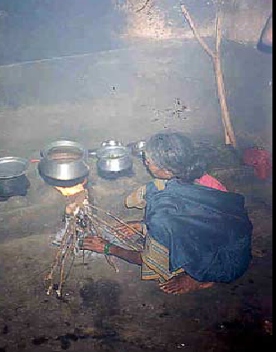
Sufficient Supply of energy
– a global problem
Need for energy is increasing
Recources should be sustainable
Environmental (carbon) footprint should be as low as possible
Energy supply
should be available
for all people at
affordable prices

Slide 3
The electric power sector experiences significant challenges
Integration of intermittent renewable sources on all levels (PV, Wind)
Fast growth in Asia (China,India)
Growing environmental awareness/requirements
New technology drives for new system solutions

Slide 4
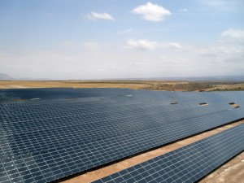
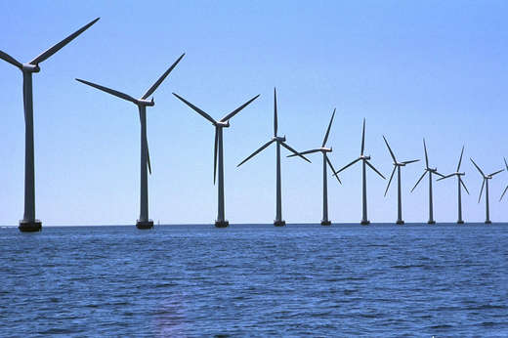
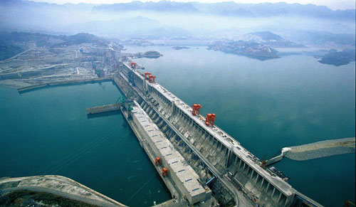
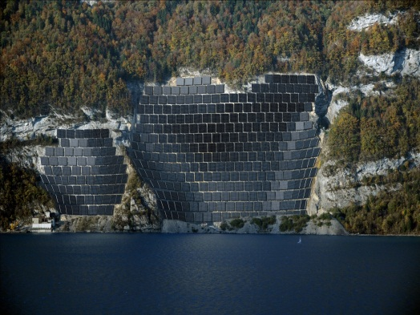
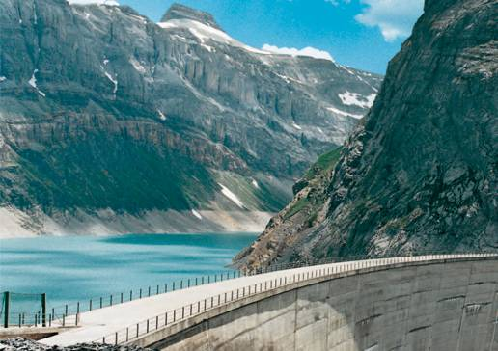
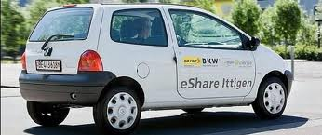
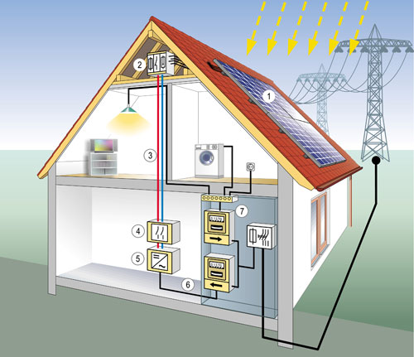
An adequate Transmission and Distribution system is crucial
High capacity transport
from remote areas
Intermittancy needs greater installed capacity and/or
storage and greater interconnection
New consumers and millions of small producers require complex and intelligent system architecture („smart grid“)

Slide 5
Technology is available
Intelligent and compact substation design
(control, visibility, offshore, easy transport)
Compact/ high capacity overhead lines
UHV 1100 kV ac
Polymer Cables up to 550 kV
HVDC up to 800 kV (1100 kV)?
Powerful ICT Tools
  (Automation, Control, Simulation, Smart Metering, Cyber Security)
Microgrids

Slide 6
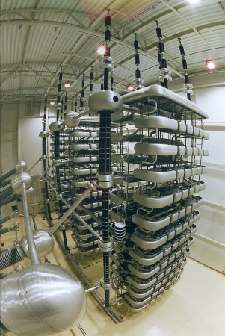
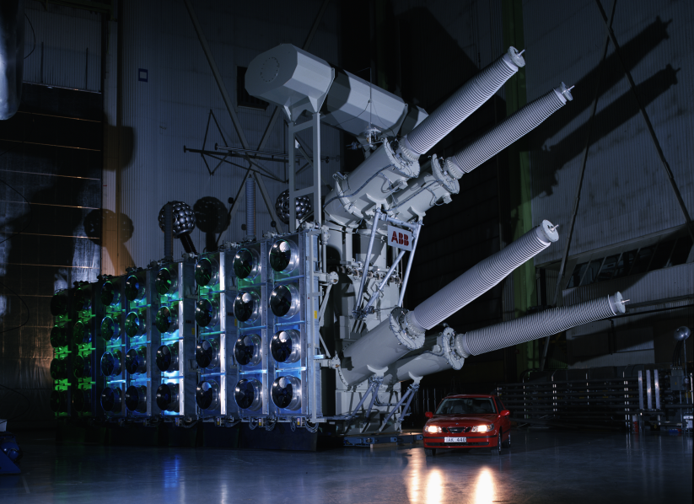
Long Distance Transmission by HVDC:
Standard +/- 500 kV
China / India +/- 800 kV (+/- 1100 kV dc)
Line comutated converters,
up to 6500 MW, Thyristors
Voltage source converters/
multi level converters
up to 1200 MW with cable
up 2400 MW with OHL
HVDC Grids seem to be feasible

Slide 7
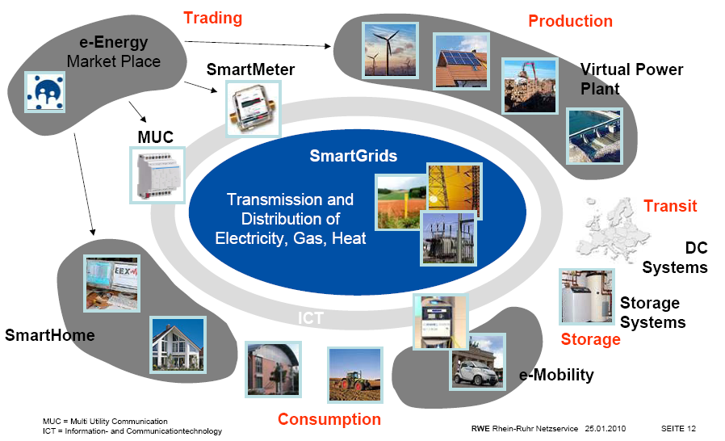
The Smart Grid Evolution

Slide 8
Key Problems
Rights of way are difficult to achieve
Investment for conventional generation is challenged by subvention of solar power «energy transition in various countries»
Interbalancing between countries and/bulk energy storage needed
Embedment of new technologies needs new appoach (HVDC Grids)
New system architecture for distribution is a challenge
It is not only a problem of technology it is also a problem of proper regulation

Slide 9
the future of the power system is a challenge for engineers, scientists, economists and polititians equally

Slide 10
CIGRE’s Role

Slide 11

What is CIGRE?
Conseil International des Grands Réseaux Électriques
International Council On Large Electric Systems
A worldwide non-profit association.
founded in Paris in 1921
Serves all stakeholders of the electric power sector
(utilities, manufacturers,universities,
institutions,regulators)

Slide 12

Mission of CIGRE
global platform ➔ worldwide network
creation, exchange and dissemination of knowledge ➔ get together
conferences, events, tutorials
publications:
Technical Brochures, ELECTRA journal,
www.e-cigre.org (free for members)
get together –
students, young engineers, experts

Slide 13
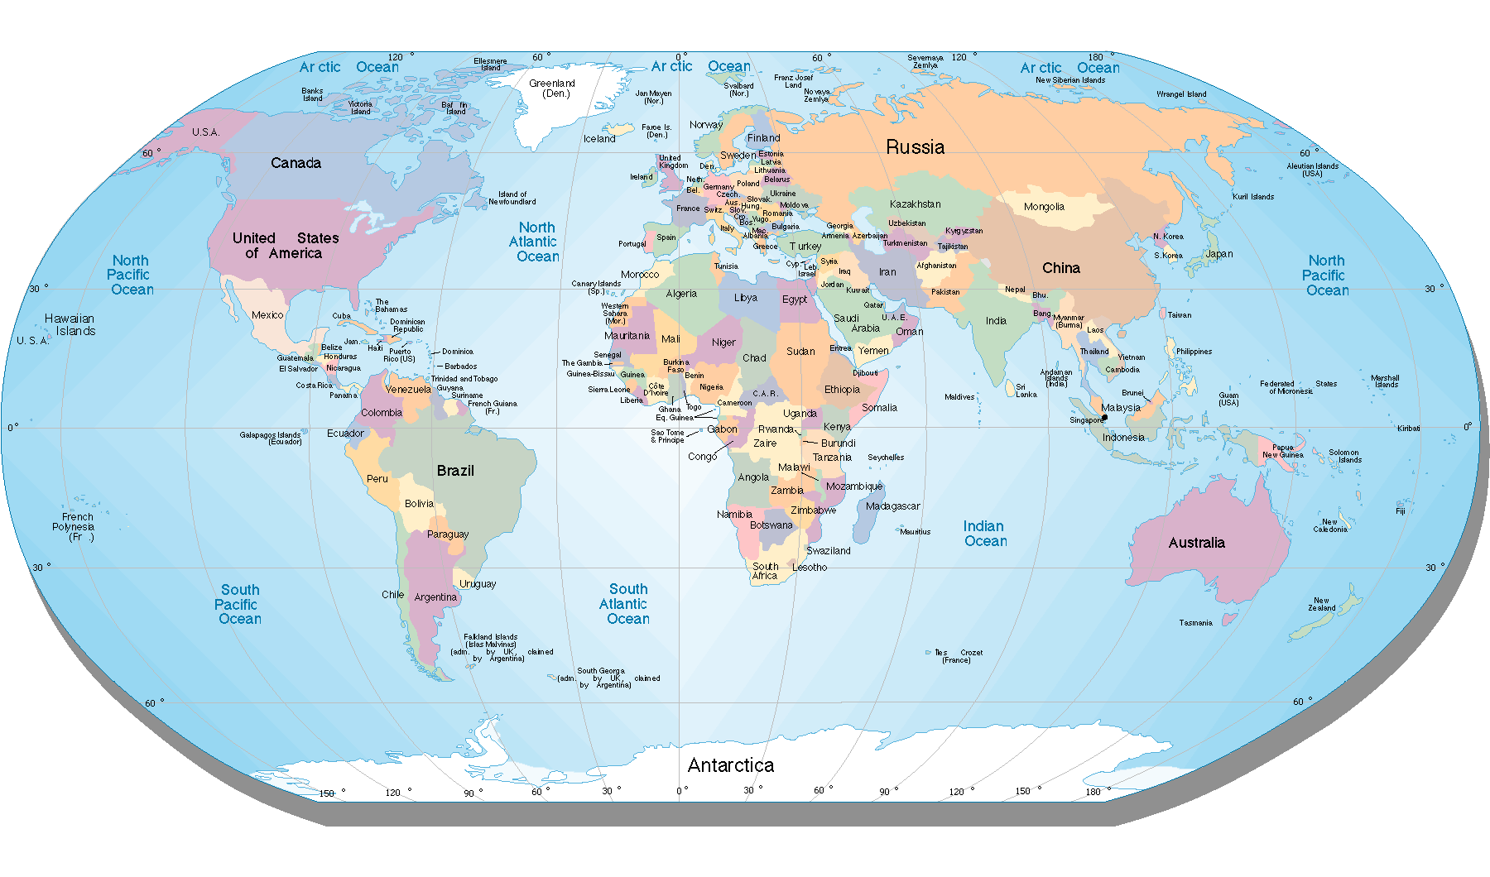
A Worldwide Network
Connecting lines are only schematical
i.e. drawn randomly

Slide 14
A Worldwide Audience
6576 individual and 1155 collective members in 89 countries
Italy
Japan
Jordan
Korea
Libya
Macedonia
Malaysia
Mexico
Montenegro
Netherlands
New Zealand
Norway
Paraguay
Poland
Portugal
Romania
Russia
Serbia
Slovenia
South Africa
Spain
Sweden
Switzerland
Thailand
Ukraine
United Kingdom
United States
Venezuela
Algeria
Andean National Committee
Arab States of the Gulf
Argentina
Australia
Austria
Belgium
Bosnia Herzegovina
Brazil
Canada
Chile
China
Croatia
Cyprus
Czech and Slovak Reps.
Denmark
Egypt
Estonia
Finland
France
Germany
Greece
Hungary
Iceland
India
Indonesia
Iran
Ireland
Israel
58 National Committees

Slide 15
CIGRE‘s Fields of activities
Market Issues
transmission
distribution
industrie
transmission
distribution
bulk
generation
private
transport,
services
...storage
Pump storage
…sources
storage
production
efficiency increase
Area of coperation
with CIRED
Environmental Topics

Slide 16
Cigre‘s Strategic Directions
Best practice
for the existing system
„The network of the future“
(Smart Grid)
CIGRE
230 Working Groups
= 3500 Experts
unbiased information
for technical and
non-technical readers
Interaction with
the environment

Slide 17
230 International Working Groups
International
Working Groups
Technical Broschures provide
Collective Knowledge

Slide 18
CIGRE’s Study Committee Structure
A1
ROTATING
ELECTRICAL MACHINES
A2
TRANSFORMERS
A3
HIGH VOLTAGE
EQUIPMENT
B1
INSULATED
CABLES
B2
OVERHEAD
LINES
B3
SUBSTATIONS
B4
HVDC & POWER
ELECTRONICS
B5
PROTECTION &
AUTOMATION
C1
SYSTEM DEVELOPMENT
& ECONOMICS
C2
SYSTEM OPERATION
& CONTROL
C3
SYSTEM ENVIRONMENTAL
PERFORMANCE
C4
SYSTEM TECHNICAL
PERFORMANCE
C5
ELECTRICITY MARKETS
& REGULATIONC5
C6
DISTRIBUTION SYSTEMS
& DISPERSED GENERATION
D1
MATERIALS & EMERGING
TEST TECHNOLOGIES
D2
INFORMATION SYSTEMS
& TELECOMMUNICATIONS

Slide 19
Key assets of CIGRE
Activities of National Committees
Study Committees and Working groups
Conferences
.. Flagship: Session in Paris with more that 3000 attandents…

Slide 20
!! Congratulations on the 90th anniversary of the Russian National Committee !!

